Slide 1
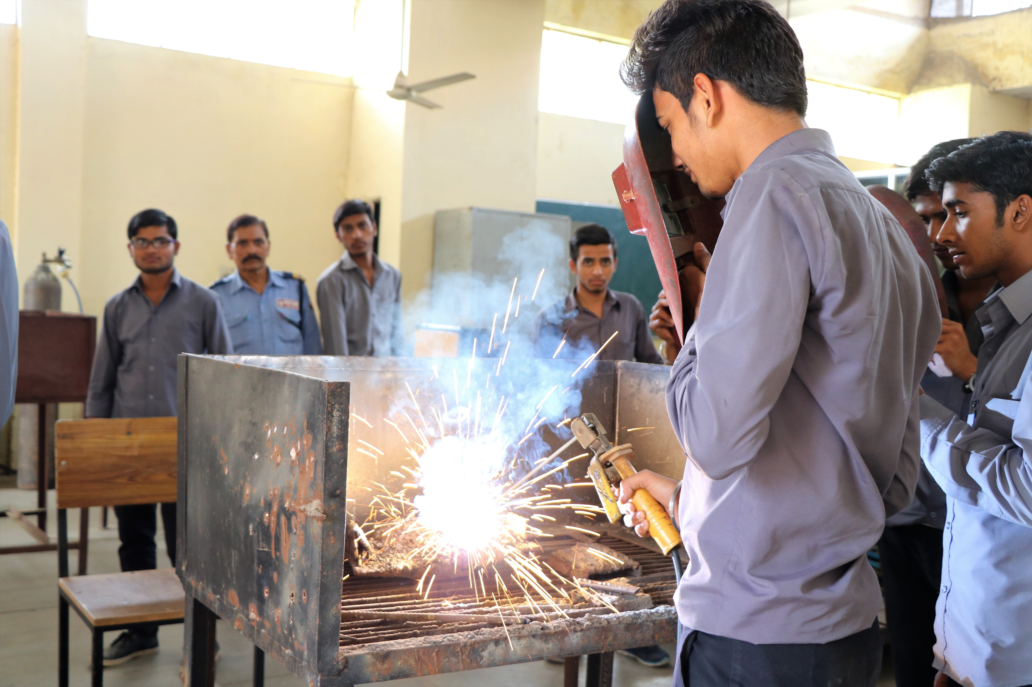


Mid-Term Evaluation
Project ‘PROTSAAHAN’
2016 - 17

Slide 2
Content
Objectives of the Study
Gaps Identified in the Scholarship Scheme and Suggested Course Correction
Research Methodology
Recommendations
International Benchmarking of the Scholarship Scheme
Conclusion
Findings from the Field

Slide 3
Objectives of the Study
End to end analysis of PROTSAAHAN scholarship scheme
Study Objectives
1
Evaluation of the beneficiary selection process and checking whether deserving beneficiaries have been selected for the scholarship project
2
Determining the impact of the scholarship scheme on the primary stakeholders
3
Assessing the attainment of the integral and intended purpose of scholarship scheme
4
Examining
beneficiaries’
perception of the scholarship project
5
Providing
recommendations for the improvement of project design and implementation

Slide 4
Research Methodology
Methods
Participants
Data Analysis
Challenges & Limitations
Primary and secondary data, Interviews, Observations, Project reports, Transect walks, other Archival data
Beneficiaries (students), Parents & guardians, Community and project leaders, Educational institutions
SPSS, Thematic Analysis, Coding
Language barrier, Unavailability of all beneficiaries, Lack of baseline data

Slide 5
International Benchmarking
of the Scholarship Scheme
CATEGORY |  | Fulbright | Chevening | Erasmus Mundus | Marshall | Rhodes | Charles Wallace | DAAD | Commonwealth | Maruti Suzuki
Expenses Covered | Tuition fee | ü | ü | ü | ü | ü | ü | ü | ü | ü
 | Living Costs | ü | ü | ü | ü | ü | ü | ü | ü | ü
 | Travel allowance | û | ü | ü | ü | û | ü | ü | ü | ü
 | Medical Insurance | û | û | ü | û | û | û | û | û | û
 | Grant for Books | û | ü | û | ü | û | û | ü | ü | ü

Slide 6
International Benchmarking
of the Scholarship Scheme
CATEGORY |  |  | Fulbright | Chevening | Erasmus Mundus | Marshall | Rhodes | Charles Wallace | DAAD | Commonwealth | Maruti Suzuki
Mandatory Requirements | Subject | Science and Technology | ü | ü | ü | ü | ü | û | ü | ü | ü
 |  | Social Sciences | ü | ü | ü | ü | ü | û | ü | ü | û
 |  | Business | û | ü | ü | ü | ü | û | ü | û | û
 |  | Art and Heritage Studies | û | û | ü | ü | ü | ü | ü | û | û
 |  | Media | û | ü | ü | ü | ü | û | ü | û | û
 | Level | Undergraduate | û | û | ü | û | û | û | û | û | ü
 |  | Postgraduate | ü | ü | ü | ü | ü | ü | ü | ü | û
 |  | Postdoc | ü | û | ü | û | û | û | û | ü | û
 |  | Age | û | û | û | û | û | ü | û | û | û
 | Nationality | Developed | û | û | û | û | û | û | û | û | û
 |  | Developing | û | û | û | û | û | û | ü | ü | û
 |  | Under -developed | û | û | û | û | û | û | û | û | û
 | Work Experience | 2 years | û | û | û | û | û | û | ü | û | û
 |  | <2 years | û | û | û | û | û | û | û | û | û

Slide 7
International Benchmarking
of the Scholarship Scheme
CATEGORY |  |  | Fulbright | Chevening | Erasmus Mundus | Marshall | Rhodes | Charles Wallace | DAAD | Commonwealth | Maruti Suzuki
Processes | Implementing Agency | Not for Profit | ü | û | û | ü | ü | û | û | û | ü
 |  | Academic partnerships w/ institutions where scholarship focused | û | ü | û | û | û | û | ü | ü | û
 |  | Government agencies focused on education | û | ü | ü | ü | û | ü | ü | ü | û
 |  | For profit organisations | û | ü | û | û | û | û | û | û | û
 | Application | Statement of Purpose | ü | ü | ü | ü | ü | ü | ü | ü | ü
 |  | Official Transcripts | ü | ü | ü | ü | ü | ü | ü | ü | ü
 |  | Letters of Recommendation | ü | ü | ü | ü | ü | ü | ü | ü | û
 |  | Curriculum Vitae | ü | ü | ü | ü | ü | ü | ü | ü | û
 |  | Income certificate | û | û | û | û | û | û | û | û | ü
 |  | Supplementary certificates focusing on past achievements | ü | ü | ü | ü | ü | ü | ü | ü | û
 | Evaluation | Academic Merit | ü | ü | ü | ü | ü | ü | ü | ü | ü
 |  | Potential for leadership | ü | ü | ü | ü | ü | ü | ü | ü | û
 |  | Past achievements | ü | ü | ü | ü | ü | ü | ü | ü | û
 |  | Interviews | û | ü | û | û | û | û | û | ü | û

Slide 8
International Benchmarking
of the Scholarship Scheme
CATEGORY |  |  | Fulbright | Chevening | Erasmus Mundus | Marshall | Rhodes | Charles Wallace | DAAD | Commonwealth | Maruti Suzuki
Outreach | Digital | Scholarship Website | ü | û | û | û | û | û | û | û | û
 |  | Presentations at Institutions | ü | ü | û | û | û | û | û | û | ü
 |  | Adverts on academic portals | ü | û | ü | û | û | û | ü | û | û
 |  | Webinars | ü | û | û | û | û | û | û | û | û
 | Face to Face | Public Events | ü | û | û | û | û | û | û | ü | û
 |  | Presentations at Host Institutions | ü | û | û | û | û | û | û | û | ü

Slide 9
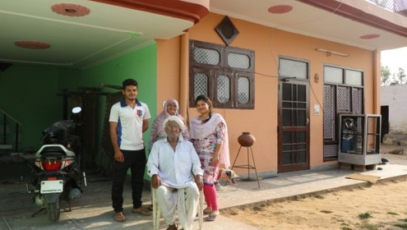
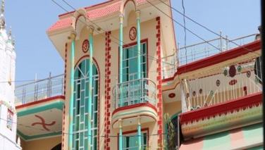
Findings from the Field
Objective 1
To evaluate whether deserving beneficiaries have been selected for the scholarship project
On the basis of records
MANESAR
10% (11 nos.) of the total beneficiaries did not meet the eligibility criteria set by MSIL
On the basis of evaluation by TISS research team
Out of 107 beneficiaries, 30 were identified as ambiguous. The proof of income did not validate the type of houses and the assets they possess
ROHTAK

Slide 10
Findings from the Field
Objective 2
To evaluate whether beneficiaries have benefited from the scholarship project
Monetary benefits
Expenditure for tuition fees, transport, books, uniform and other educational material was met
Less financial burden on parents
Motivation to complete their education

Slide 11
Findings from the Field
Objective 3
To assess whether the integral and intended purpose of the scholarship project has been achieved
Expenditure for tuition fees, transport, books, uniform and other educational material was met
High dropout rate observed among Polytechnic and Engineering students
Course | Scheme Dropout | Not placed
ITI (One Year) | - | 91%
ITI (Two Year) | 21% | 19%
Polytechnic | 73% | -
Engineering | 50% | -
Poor placements in ITIs

Slide 12
Findings from the Field
Objective 4
To explore the beneficiaries’ perception of the scholarship project and to assess the extent of beneficiary satisfaction with the scholarship project
This section presents beneficiaries’ perception towards the application process, execution of the scheme, disbursement of the scholarship grant and involvement of implementing agency:
84% satisfied with the application process
70% satisfied with the eligibility criteria of 60% and above
62% dissatisfied with the income ceiling of 3 lakhs
 | Highly Satisfied | Satisfied | Neutral | Dissatisfied | Highly dissatisfied
Scholarship application procedure | 20% | 55% | 0 | 9% | 2%
Income ceiling of below Rs. 3 lakhs | 0 | 16% | 18% | 63% | 4%
Marks 60% | 9% | 61% | 2% | 29% | 0

Slide 13
Findings from the Field
Objective 4
Gaps Identified in the Scholarship Project
Gaps
Course correction suggested
01
Ambiguity in the selection process was observed
Standardization of the selection process is required – only class 10th should be considered for ITI courses
Personal Interview should be conducted to determine aptitude and motivation of the students
Home visit is strongly recommended to assure ‘means’ criteria for beneficiary selection
Marks certificate was collected from the students of both class 10th and 12th for selection process
No interviews were conducted under selection process
Less clarity on home visits conducted by the implementing agency

Slide 14
Findings from the Field
Objective 4
Gaps Identified in the Scholarship Project
Gaps
Course correction suggested
02
Gaps in the application form
Different score card should be used for different course
Application form should be bilingual (English & Hindi), comprehensive and legible
Application form is in English – 90% of the students and most of the parents were unable to read
03
No preference and relaxation (in marks)
Relaxation of 5% in marks for socially and economically deprived communities (SC/ST)
For socially and economically deprived communities of the society (under both means and merit criteria)

Slide 15
Findings from the Field
Objective 4
Gaps Identified in the Scholarship Project
Gaps
Course correction suggested
04
The amount given as scholarship grant exceeded the cost requirements
Revaluation of the scholarship amount
Limit the monetary aid and channelize the surplus towards workshops for personality development and improved communication skills to be conducted regularly

Slide 16
Findings from the Field
Objective 4
Gaps Identified in the Scholarship Project
Gaps
Course correction suggested
05
Student s should be given one chance if they get compartment or backlog in one paper only
Scholarships should be continued as per % obtained by the students
High dropout rate among Polytechnic & Engineering students
Annual Disbursement (3 years) | Rs.32,300/- | Percentage Score | Release of amount | Polytechnic
 |  | 60% - 70 % | 25% | Rs.8,075
 |  | 70% and above | 50% | Rs.16,150
Annual Disbursement (4 years) | Rs.70,000/- | Percentage Score | Release of amount | Engineering
 |  | 6o% - 70 % | 25% | Rs.17,500
 |  | 70% and above | 50% | Rs.35,000

Slide 17
Findings from the Field
Objective 4
Gaps Identified in the Scholarship Project
Gaps
Course correction suggested
06
Low participation of girls was observed (4 out of 107 beneficiaries)
Relaxation of 5% in marks for girls
Providing scholarship to other courses like nursing, paramedical, teaching etc.
07
No placements were held for one year course in ITIs (91% not placed)
Scholarship for one year course in ITI should be discontinued

Slide 18
Findings from the Field
Objective 4
Gaps Identified in the Scholarship Project
Occupation | 0 - 50000 | 50000 - 1 Lakh | 1 - 1.5 Lakh | 1.5 - 2 Lakh | 2 - 2.5 Lakh | 2.5 - 3 Lakh | Above 3 Lakhs | Total
Waged/seasonal labour | 5 | 21 | 3 |  |  |  |  | 29
Farmer |  | 8 | 4 |  |  | 1 |  | 13
Dairy/Animal Husbandry |  |  |  |  |  |  |  | 0
Industrial worker |  |  |  |  |  |  |  | 0
Business |  | 5 | 3 | 4 |  |  |  | 12
Government employee |  | 4 | 1 | 1 | 1 | 2 | 1 | 10
Private employee | 1 | 29 | 5 |  | 3 |  |  | 38
Others | 1 | 2 | 2 |  |  |  |  | 5
Total | 7 | 69 | 18 | 5 | 4 | 3 | 1 | 107
Gaps
08
Ambiguity in income certificate
Course correction suggested
Salary slip is mandatory for private and government employee – No income certificate/affidavit should be entertained

Slide 19
Findings from the Field
Objective 5
Proposed Score card for Identification of beneficiaries by mean factor
SN | Options | 4 |  | 3 | 2 | 1 | Max Marks
1 | Type of house | Kuchha = 4 |  | Semipucca = 3 | Pucca = 2 | RCC = 1 | 4
2 | Category (SC/ST) | Yes = 8 , No = 0 |  |  |  |  | 8
3 | Gender | Woman/3rd gender = 8, Male = 0 |  |  |  |  | 8
4 | Disability | Disabled = 2, Not disabled = 0 |  |  |  |  | 2
5 | Woman headed household | Yes = 2, No = 0 |  |  |  |  | 2
6 | Land holding | Landless = 1.5 |  | Less than 2 ha = 1 | 2-5 ha = 0.5 | Above 5 ha = 0 | 1.5
7 | Annual Income | Below 50000 = 4 |  | 50000-1 Lakhs = 3 | 1 - 1.5 = 2 | Above 1.5 Lakhs = 1 | 4
8 | Education of parents/first generation learners | Illiterate = 2 |  | Primary to Upper Primary = 1.5 | SSC to HSC = 1 | Graduation and Above = 0 | 2
9 | Loan status | Above 100000 = 1.5 |  | 50000 to 100000 = 1 | 25000 to 50000 = 0.5 | 0 to 25000 = 0 | 1.5
10 | Type of schooling | Government = 4 |  | Semi Govt. = 3 | Private = 2 | Convent = 1 | 4
11 | Vehicle possession | None/ Cycle = 1.5 |  | Ordinary two Wheeler = 1 | Two Wheeler - costing more than 60000 = 0.5 | Four Wheeler = 0 | 1.5
12 | Household Assets any 3 or less assets = 1.5, any 4 asset = 1, any 5 asset or more = 0 |  |  |  |  |  | 1.5
12.1 | Fridge
12.2 | Washing Machine
12.3 | Television
12.4 | Inverter
12.5 | Air conditioner
Total |  |  |  |  |  |  | 40
Recommendations
Restructuring of scorecard
It is recommended that the scorecards for both ‘merit’ and ‘means’ be restructured; furthermore home visits and personal interview are strongly recommended for identification of the right (needy) beneficiaries.
The weightage can be restructured as 40:40:20 (merit : means: aptitude)

Slide 20
Findings from the Field
Objective 5
Recommendations
Needs assessment study
Revision of accorded weightage to the criteria of selection
Project monitoring and evaluation
MSIL is recommended to conduct a needs assessment study to have thorough information and in-depth knowledge of the dynamics of the community
It is recommended that equal weightage be accorded to ‘Merit’ and ‘Means’ as criteria for selection of beneficiaries; the revised weightage should be, Merit – 40%, Means – 40%, Personal Interview – 20% (merge with point one)
It is advisable that an additional SEEDS representative be deputed at the project locations (Rohtak, Manesar and Gujarat) for efficient tracking and execution of the project.

Slide 21
Findings from the Field
Objective 5
Recommendations
Timely disbursement of scholarship amount
Re-structuring of the renewal mechanism
Provisioning for additional support facilities
It is recommended that in case of renewal of scholarships, the amount should be disbursed to the beneficiary’s account immediately after the completion of the semester (rather than disbursement of the scholarship amount post the felicitation ceremony). Beneficiaries who have qualified for renewal of scholarship should be asked to join felicitation for experience sharing and for motivating freshers’.
It is recommended that the renewal mechanism be restructured; the renewal of scholarship should be based on the marks obtained by the beneficiary, and beneficiaries should not be removed from scheme if they have merely failed one paper. This would help address the issue of dropouts from long duration course such as Polytechnic and Engineering.
Apart from providing the monetary aid in terms of scholarship, it is advisable that MSIL provides for additional support facilities such as coaching, mentoring, career counselling and the like to further motivate and build the capacity of the beneficiaries to pursue the respective programmes/ courses.

Slide 22
Findings from the Field
Objective 5
Recommendations
Periodic MSIL Official Visits
Reconsideration of the scholarship amount
Introduction of additional programmes/ courses
It is recommended that MSIL official/s periodically visit the project locations and interact with students for motivation and inspiration.
As reflected in the report, the beneficiaries have also apparently spent the scholarship amount for domestic and miscellaneous expenses, apart from educational purposes. Thereby it is recommended that MSIL rework their scholarship amount, such that it is sufficient towards meeting educational requirements of the beneficiaries (without leaving extra amount that can be used to cover domestic/ miscellaneous expenditures).
Considering the lower inclination of women towards pursuing technical courses/ programmes, it is recommended that MSIL introduces additional course such as B.SC

Slide 23
Conclusion
“
The PROTSAAHAN Scholarship Scheme has been appreciated by all the communities across all three locations (Rohtak, Manesar and Gujarat) during interviews and group interactions. The MSIL initiatives are applauded by the beneficiaries, their parents, local leaders, schools and colleges. In addition to monetary support, MSIL can focus on placements and creating job opportunities for the beneficiaries. New ideas and approaches should be explored to ensure inclusivity of the social and economic backward class.

Slide 24
Thank You!

